Slide 1
Software Development Life Cycle (SDLC)

Slide 2
AGENDA
Understanding the Software Development Lifecycle
Working on an Agile Team
Software Testing and Quality Assurance
Software Testing Tools and Techniques
Communication and Collaboration
Common Tools (ServiceNow, JIRA, etc.)

Slide 3
What we are trying to Accomplish?
Understand what is SDLC
Purpose of SDLC
Phases of the SDLC (requirements gathering, design, development, testing, deployment, and maintenance)
Importance of following a structured SDLC process

Slide 4
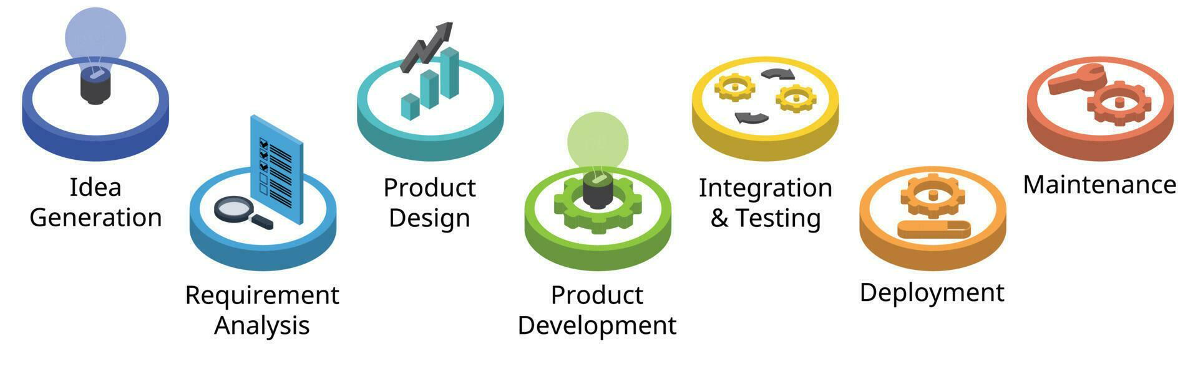
Understanding the Software Development Lifecycle
SDLC stands for Software Development Life Cycle
It is a structured process used to develop and maintain software systems
SDLC consists of a set of phases or stages that guide the software development process from start to finish
Notes:
SDLC stands for Software Development Life Cycle. It is a structured approach used in software engineering to guide the process of developing software applications. The SDLC defines a series of phases that a software project goes through, from conception to deployment and maintenance. Each phase has specific goals, activities, and deliverables, ensuring a systematic and well-organized development process.
Typical process in SDLC are:
Idea generation is the initial and crucial phase in the Software Development Life Cycle (SDLC) where new software projects are conceived. This phase involves identifying problems, opportunities, or needs that can be addressed through the development of a software solution. You need to undergo common techniques like Brainstorming, Market Research, User Feedback, Competitor Analysis, POC, Innovation workshops, etc.,
Requirement analysis in the Software Development Life Cycle (SDLC) is a crucial and systematic process of understanding, defining, and documenting the needs and expectations of stakeholders for a software project. It involves gathering, organizing, and clarifying requirements to ensure that the final software product meets the desired objectives and satisfies the users' needs. Major steps like gathering requirements, eliciting them, analyzing, organizing and documenting requirements, validating them should be performed.
Product design is a crucial phase in the Software Development Life Cycle (SDLC) where the requirements gathered during the requirement analysis phase are transformed into a detailed design specification for the software product. The design phase lays the foundation for the development process and guides the construction of the software system. More detailed design structure should be performed by the team like System Architecture Design, Detailed Design, UI design, DB design, prootyping, Security and performance considerations, design documentations, reviewing and validating them, feasibility assessment and technology selection.
Product development in the Software Development Life Cycle (SDLC) refers specifically to the process of creating and releasing a software product. It involves a series of well-defined steps to design, build, test, and deploy the software.
Integration and testing are two critical phases in the Software Development Life Cycle (SDLC) that follow the product design and development stages. These phases focus on ensuring that the individual software components or modules work together as intended and that the entire system functions as expected.
Deployment in the Software Development Life Cycle (SDLC) refers to the process of releasing the developed software to the production environment for actual use by end-users or customers. It is the final stage of the SDLC, following the completion of product design, development, integration, and testing. Deployment involves making the software available and accessible to the intended audience.
Maintenance is an essential phase in the Software Development Life Cycle (SDLC) that comes after the deployment of the software product. It involves managing, updating, and enhancing the software to ensure it continues to meet user needs, remains reliable, and stays compatible with changing environments. Maintenance encompasses various activities to keep the software in good working condition and to address issues that may arise during its operational life.

Slide 5

CIRCLE of Life
Teams come, operate, evolve and disband
People come, grow, and eventually move on
Projects come, grow, evolve and enter stasis
Your project has to accommodate these facts of project lifecycle!!
Notes:
The "Circle of Life" in the context of the Software Development Life Cycle (SDLC) refers to the continuous and iterative nature of the software development process. It signifies that software development is not a linear, one-time activity but rather a cyclical and ongoing process. The software development life cycle follows a loop-like pattern, where each completed cycle leads to the beginning of a new one.

Slide 6
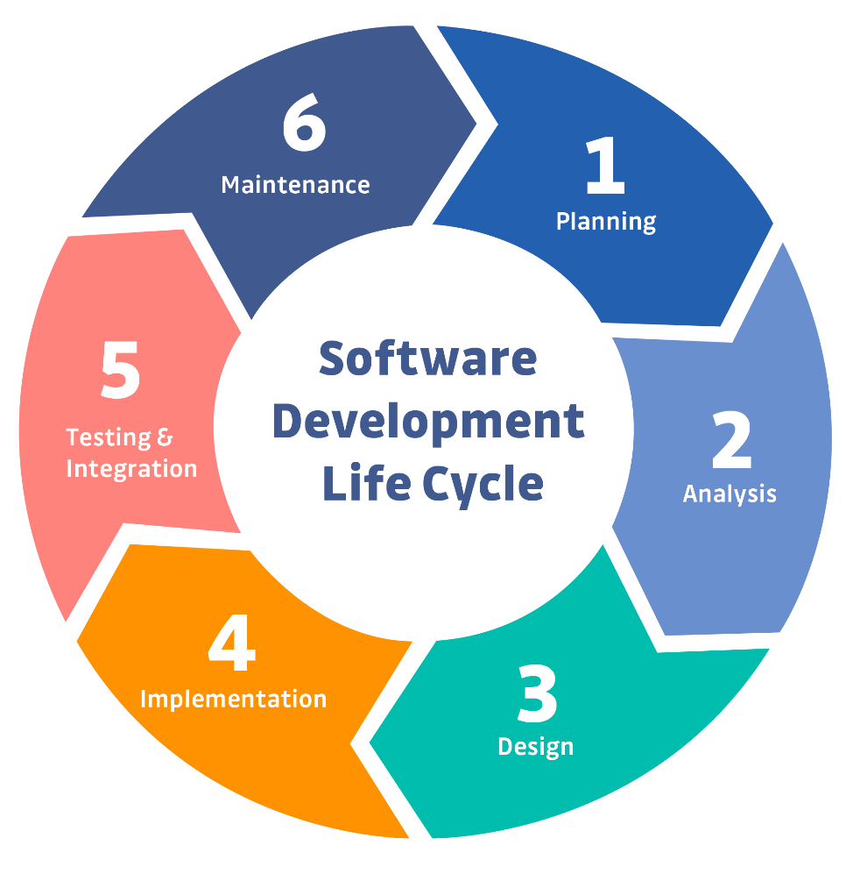
Software Development Life Cycle (SDLC): Why?
Purpose
Leads to good software
Reduces risk
Enables visibility and measurement
Enables team’s teaming
Key attributes
Outcomes of processes or products are key deliverables
Roles are clear
Pre- and post-conditions are understood and held true
Notes:
The purpose of the Software Development Life Cycle (SDLC) is to provide a structured and systematic approach to developing high-quality software products. SDLC serves as a framework that guides software development teams through a series of well-defined phases, ensuring that the software project progresses in an organized and controlled manner.
The key attributes of the Software Development Life Cycle (SDLC) define its characteristics and principles that guide the development process. These attributes are crucial for effective software development and successful project management.

Slide 7
Phases of the SDLC
The SDLC (Software Development Life Cycle) comprises several essential phases:
Requirements Gathering: Identifying and documenting project needs and objectives by consulting stakeholders.
System Analysis: Evaluating existing systems and defining requirements for the new system.
System Design: Planning the software architecture and user interface.
Coding and Implementation: Writing and integrating the code to create the software.
Testing: Executing tests to ensure the software's functionality and quality.
Deployment: Launching the software for users to access and utilize.
Maintenance and Support: Providing ongoing support, updates, and improvements to the software.
Notes:
-Requirement gathering, also known as requirements elicitation or requirements analysis, is a crucial phase in the Software Development Life Cycle (SDLC). It involves understanding, capturing, and documenting the needs and expectations of stakeholders to define the software's functional and non-functional requirements. Proper requirement gathering sets the foundation for the entire development process and ensures that the final software product meets the desired objectives.
-
-The system analysis phase is critical for setting the right direction for the software development project. It ensures that the development team has a clear understanding of the project's objectives, requirements, and constraints. The output of this phase serves as the foundation for the subsequent phases of the SDLC, including system design, implementation, testing, and deployment. Proper system analysis reduces the risk of misunderstandings and rework during development and increases the likelihood of delivering a successful software solution that meets the stakeholders' expectations.
-
-The system design phase is crucial for ensuring that the software development team has a clear plan and direction for building the software. It reduces the risk of misunderstandings and deviations during development, as the detailed design specifications serve as a reference for the implementation phase. A well-executed system design phase results in a more efficient and successful software development process, leading to the creation of a high-quality, reliable, and user-friendly software product that aligns with the stakeholders' requirements and expectations.
-
-Coding and implementation are the phases in the Software Development Life Cycle (SDLC) where the actual development of the software takes place. After the system design phase, where the software's detailed specifications are prepared, developers start writing the code to build the software product.
-
-Testing is a critical phase in the Software Development Life Cycle (SDLC) that ensures the quality, reliability, and functionality of the developed software. It involves systematically evaluating the software to identify defects, verify that it meets the specified requirements, and validate that it functions as expected. Testing is conducted at various levels of the software development process to catch issues early and provide confidence in the software's performance.
-
-Deployment in the Software Development Life Cycle (SDLC) is the phase where the developed software is released to the production environment and made available for end-users or customers. It is the final stage of the SDLC, following the completion of coding, testing, and other development activities. Deployment involves the actual implementation of the software in the live environment where it will be used.
-
-Maintenance and support are crucial phases in the Software Development Life Cycle (SDLC) that occur after the deployment of the software. These phases are focused on ensuring the ongoing functionality, reliability, and usability of the software, as well as providing assistance to users and addressing any issues that may arise.

Slide 8
Benefits of the SDLC
Increased Quality
Reduced Risk
Increased Efficiency
Improved Communication
The SDLC helps ensure that software is developed to a high standard by following a structured process
The SDLC helps reduce the risk of project failure by identifying and mitigating risks early in the process
The SDLC helps improve communication between stakeholders by defining clear roles and responsibilities
The SDLC helps improve efficiency by providing a sustainable process that can be used to develop software more quickly and effectively
Notes:
-Increased quality in the Software Development Life Cycle (SDLC) is essential to deliver software products that meet user expectations, perform reliably, and provide a positive user experience. Achieving higher quality in SDLC involves adopting various practices and strategies throughout the development process.
-
-Reducing risks in the Software Development Life Cycle (SDLC) is essential to ensure the successful delivery of software projects within budget and schedule, and to meet user expectations. Risks in SDLC can arise from various sources, including technical challenges, resource constraints, scope changes, and external factors.
-
-Improved communication is a critical aspect of the Software Development Life Cycle (SDLC) that significantly contributes to the success of a software project. Effective communication ensures that all stakeholders, including developers, project managers, clients, and end-users, have a clear understanding of the project's goals, progress, and challenges.
-
-Increasing efficiency in the Software Development Life Cycle (SDLC) is crucial for delivering software projects on time, within budget, and meeting quality standards. Improved efficiency helps streamline the development process, reduces waste, and maximizes productivity.

Slide 9

Software Development Methodologies
There are a number of different software development methodologies including
Waterfall
Agile
Rapid application development (RAD)
Extreme programming (XP)
Scrum
Notes:
Waterfall methodology – a sequential, activity-based process in which each phase in the SDLC is performed sequentially from planning through implementation and maintenance
Rapid application development methodology (RAD) – emphasizes extensive user involvement in the rapid and evolutionary construction of working prototypes of a system to accelerate the systems development process
Extreme programming (XP) methodology – breaks a project into tiny phases, and developers cannot continue on to the next phase until the first phase is complete
Agile methodology – a form of XP, aims for customer satisfaction through early and continuous delivery of useful software components

Slide 10
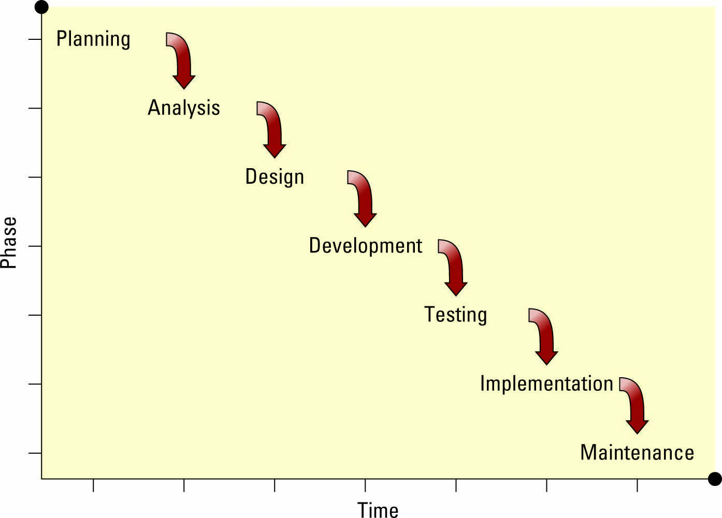
Waterfall Methodology
Waterfall methodology – A sequence of phases in which the output of each phase becomes the input for the next
Notes:
The waterfall methodology is one of the oldest software development methods and has been around for more than 30 years
The success rate for software development projects that follow this approach is only about 10 percent, or 1 in 10
The biggest problem with the waterfall methodology is that it assumes users can specify all business requirements in advance
Ask your students to define another issue with the waterfall methodology
Ans: It also assumes that business requirements do not change over time
Stress to your students that if they ever find themselves on a software development project that is using the waterfall methodology, they should do everything they can to change the methodology
●Waterfall methodology – a sequential, activity-based process in which each phase in the SDLC is performed sequentially from planning through implementation and maintenancee in modern software development practices.

Slide 11

In the beginning…
Waterfall.
Requirements
Analysis
Design
Implementation
Testing
Deployment
6 months

Slide 12

Agile Methodology
Iterative development – Consists of a series of tiny projects
Agile methodology – Aims for customer satisfaction through early and continuous delivery of useful software components developed by an iterative process using the bare minimum requirements
Notes:
The Agile Alliance is a group of software developers whose mission is to improve software development processes and whose manifesto includes the following:
Satisfy the customer through early and continuous delivery of valuable software
Welcome changing requirements, even late in development
Business people and developers must work together daily throughout the project
Build projects around motivated individuals
The best architectures, requirements, and designs emerge from self-organizing teams
At regular intervals, the team reflects on how to become more effective, then tunes and adjusts its behavior accordingly
●
●Agile methodology – a form of XP, aims for customer satisfaction through early and continuous delivery of useful software components

Slide 13

SCRUM Methodology
Scrum – Uses small teams to produce small pieces of deliverable software using sprints, or 30-day intervals, to achieve an appointed goal
Under this methodology, each day ends or begins with a stand-up meeting to monitor and control the development effort
Notes:
Scrum provides a framework for continuous improvement, allowing teams to adapt to changing requirements, customer feedback, and market dynamics. The iterative nature of Scrum allows for frequent inspection and adaptation, enabling teams to deliver high-quality products and respond to changes quickly.
Overall, Scrum is a widely used and effective framework for managing software development projects. It promotes collaboration, transparency, and customer satisfaction, making it a popular choice among Agile methodologies for modern software development.

Slide 14

Minimizing waste and maximize feedback

Slide 15
The difference between what I think is valuable and what is really valuable creates waste
Waste

Slide 16


Paul the master gardener, has a intuitive sense of what needs to be done next. He knows in his bones what matters and what doesn’t.
I might think perfectly straight rows are really important. I put a lot of effort into making my rows straight.
Along comes Paul and says "Why are you working so hard at making the rows straight? What you need is more compost."
Paul

Slide 17
Software development is full of waste of overproduction
Fat requirement documents that rapidly grow obsolete
Elaborate architectures that are never used
Code that goes months without being integrated, tested and executed in a production environment
Documentation no one reads until it is irrelevant or misleading
While all these activities are important to software development, we need to use their output immediately in order to get the feedback we need to eliminate waste
Notes:
People get passionate about coding style. While there are undoubtedly better styles and worse styles. The most important style issue is that team chooses to work towards a common style.
If everyone on the team chooses to focus on what’s important to the team, what is they should focus on? XP embraces five values to guide development:
Simplicity
Communication
Feedback
Courage
Respect

Slide 18
The Toyota Story
Controlling waste

Slide 19

Taiichi Ohno
Industrial engineer with Toyota
Post WWII reconstruction
Goal of competing with US auto industry
Limited resources
Focus on controlling what could be controlled
Believed in the potential of the team
“Progress cannot be generated when we are satisfied with existing solutions.”
- Taiichi Ohno
Notes:
KEY POINTS:
Let’s look at the foundations of Operational Excellence…where it came from.
After World War II, the infrastructure of Japan had been devastated.
Resources were VERY scarce. Having to rebuild factories left very little for actual production.
Taiichi Ohno was an industrial engineer in one of Toyota’s factory.
He was challenged with the goal of competing with the US’s auto industry, which was experiencing a boom in growth after the war: plenty of resources available for their production.
Ohno focused on an intense focus of controlling what could be controlled. Eliminate all waste. Do not allow individuals to do redundant work. Reduce all non-productive work.
Ohno also believed in the potential of the team. Give them a goal and then drive them to find the best way to achieve it.
His factory was the only one to turn a profit. Other factory managers thought he was falsifying his results. Government did an audit and found paperwork to be accurate.
Took his strategy for success and shared it with other factories. Saved the Toyota business and influenced much of Japan’s economic recovery.
Invented Kanban: One of the main goals of Kanban is to limit the build-up of excess inventory at any point on the production line.

Slide 20
/reads/toyota
github.com/the-code-camp/stem-sdlc/
Notes:
https://github.com/the-code-camp/stem-sdlc/tree/main/reads/toyota

Slide 21
Activity: Toyota story
How is the waste controlled in Toyota?
List some of the advantages to the organization by controlling waste.
Suggest some of ways how waste can be controlled in software development
Notes:
Activity: 20 minutes

Slide 22
Thank You

